Slide 1
Why ‘R’

Slide 2
I needed stats software for my students
For my training
STATA (phD)
EpiInfo (MSc)
For the 1st MPH class Dr Osman is teaching Epi-info but we were keen for a more robust software
So thought of my Stats guru
What is the way forward?

Slide 3
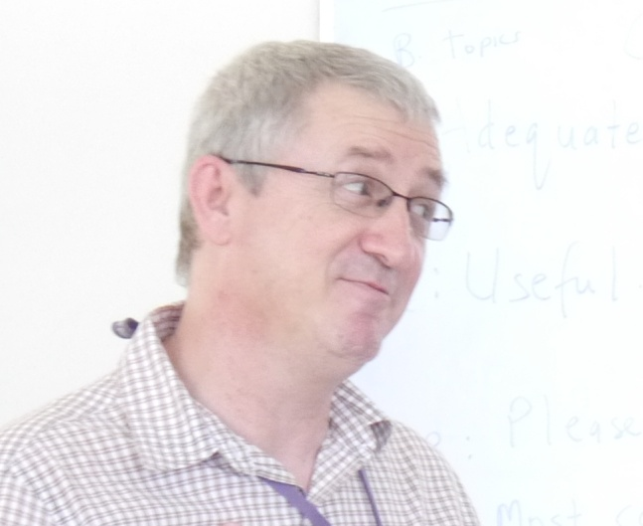
R

Slide 4
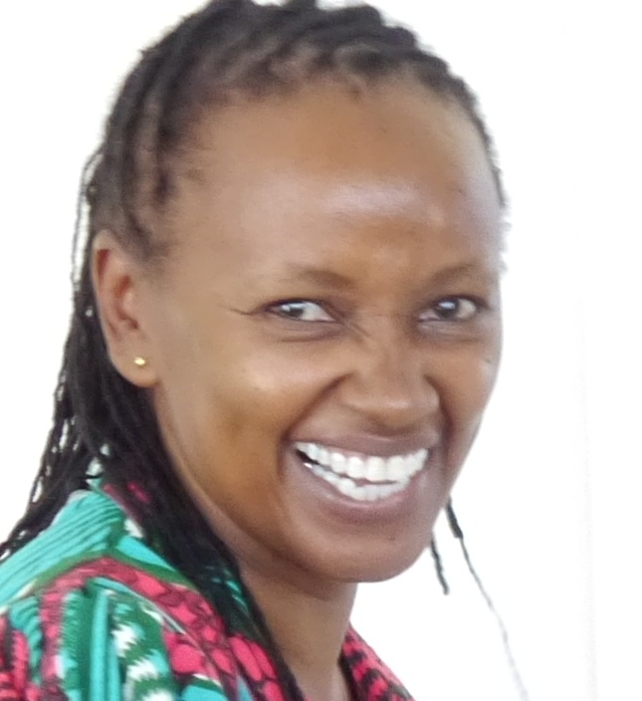
R?……you are kidding right?

Slide 5

HE PUT IT IN A LANGUAGE THAT I UNDERSTAND…..

Slide 6
THE OTHERS
STATA
They don’t even show you the price – you actually have to log in and fill a form to get it
http://www.stata.com/order/lab-quote-request/
KEMRI-Wellcome trust program in Kilifi spend 2,000 US$ upgrading their STATA license 2014
SAS
SPSS
Other

Slide 7
Cost compared to ‘R’
SAS
SPSS
STATA
R
FREE

Slide 8
Who will Prof Rajab listen to and support?

Slide 9
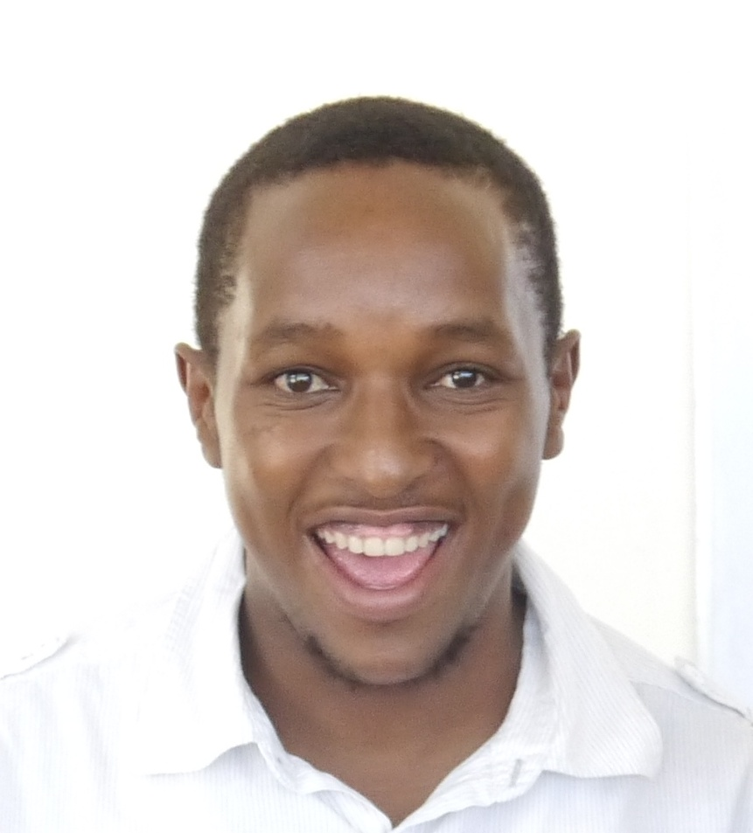
KEN MWAI
Greg passed me to this young man who has been the backbone of the R-workshops we have hosted in Pwani University

Slide 10
First ‘R’ stats workshop for post-graduate students in SPAS
10th – 21st February, 2014

Slide 11
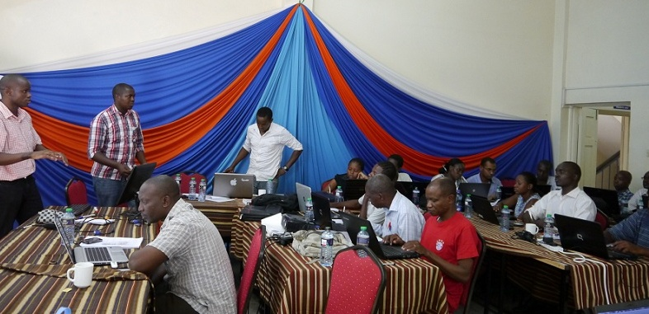
10th – 21st February, 2014
A total of 20 students
8 Masters in Public Health
3 MSc Fisheries students
5 MSc Microbiology
1 MSc Environmental Science
2 MSc Entomology students
1 PhD in Fisheries

Slide 12
10th – 21st February, 2014
KEMRI-Wellcome Trust Research Program, Kilifi | KEMRI-Wellcome Trust Research Program, Nairobi | Pwani University
Dr Greg Fegan | Dr Phillip Ayieko | Dr Rose Kigathi
Ken Mwai | Lucas Malla | Dr James Tuju
John Ojal | Gabriel Otieno | Dr Tabitha Mwangi
Mark Otiende
Michael Ooko
Leonard Wafula
Alex Mutuku
Boniface Kaaria

Slide 13
Lessons learned (sorted)
Too much time wasted downloading materials
Materials were put on a CD that was given to each student but this slowed the training
Pwani university server set up for this purpose
Some students last did stats in high school
Students must be exposed to stats in class first
Lack of uniformity with plethora of facilitators
Reduced number of facilitators
Put all presentations on markdown ahead of workshop

Slide 14
Second statistics workshop for post-graduate students in SPAS
9th – 20th February, 2015

Slide 15
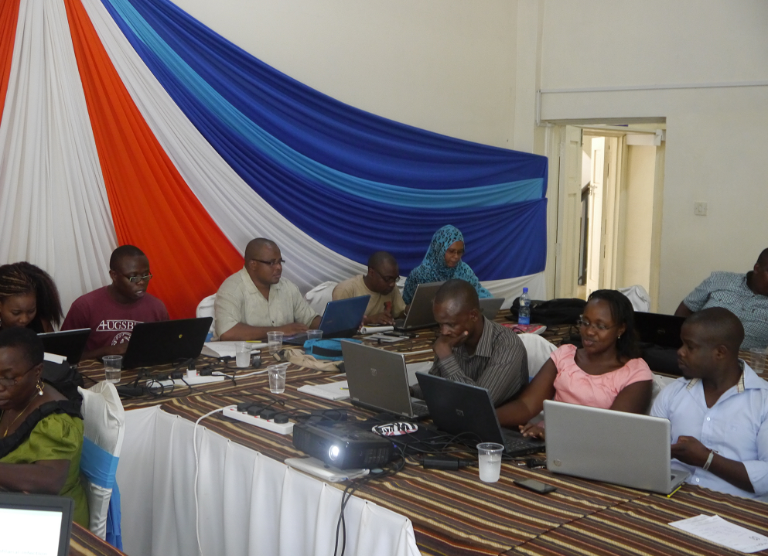
9th – 20th February, 2015
21 students
10 Masters in Public health
6 Masters in Statistics
3 MSc Fisheries and Microbiology
1 PhD in Fisheries
1 Staff (Prof HassanAli)

Slide 16
9th – 20th February, 2015
KEMRI-Wellcome Trust Research Program, Kilifi | KEMRI-Wellcome Trust Research Program, Nairobi | Pwani University
Dr Greg Fegan | Dr Phillip Ayieko | Dr Leonard Kiti
Ken Mwai |  | Dr Osman Abdullahi
Mark Otiende |  | Dr Tabitha Mwangi
Michael Ooko |  | Dr Rose Kigathi
Leonard Wafula
Alex Mutuku

Slide 17
We are getting better
Students more confident –those who had not covered the statistics course in class were not allowed to attend
The days were shorter and a lot more was covered
no time wasted downloading material due to good network due to the local server

Slide 18
Lessons learned (not sorted yet)
Not able to cater for all student needs
Mainly targeted to public health students
Fisheries, Agriculture, animal science
‘Trainer of trainers’ workshops idea born
A few students not attending all sessions
A fee (2,000/-) added to the second workshop did not solve the problem
Inability to pay facilitators
All facilitators earn nothing
Might be impossible to sustain
Idea of commercializing R workshop born

Slide 19
Why trainer of trainers workshops
To cater for all specializations
Fisheries, Education, Economics, Social sciences, Physical sciences
To enable a larger group of students to be introduced to ‘R’
To enable ‘R’ to spread to both under-graduate and post-graduate students
To enable Pwani University to stand independently of KEMRI in running workshops
To collaborate but not from a place of neediness
To build skills to enable R workshops to be run commercially from Pwani University

